Slide 1

AI WORKFLOW GUIDE
AI in Communication
A Comprehensive Guide to Understanding, Generating, and Optimizing Human Language across Modern Workflows
psychology
auto_awesome
tune
01. Understanding
Analyze linguistic patterns, semantics, and context for deep language comprehension.
02. Generating
Craft coherent drafts, smart replies, and structured content instantly in real time.
03. Optimizing
Refine tone, enhance readability, and streamline daily team communication workflows.

Slide 2




6-Hour Course Roadmap
Hour 03
Hours 05 & 06
Smart email management, auto-categorization, & priority response times.
Grammarly account setup, tone detection, and advanced clarity preferences.
Hours 01 & 02
Hour 04
Introduction to AI, language patterns, smart writing, & tone adjustments.
Overview of NLP frameworks, customer chatbots, & speech-to-text.

Slide 3



What is AI in Communication?
Core AI Systems
Professional Impact
Artificial Intelligence systems that analyze patterns in language to understand, generate, and optimize human communication in real time.
Powers smart chatbots, writing assistants, email management, and automated content creation across modern enterprise tool stacks.
KEY DEFINITION
CORE TRANSFORMATION
AI predicts context and semantics to craft clear, coherent, and highly effective digital interactions.
Fundamentally transforms how professionals write, speak, and collaborate in fast-paced workplace environments.

Slide 4






Foundations of AI Writing
Language Analysis
Tone Adjustment
Smart Composition
AI evaluates linguistic patterns to predict next-word probabilities, improve clarity, and suggest contextual phrasing instantly.
Seamlessly shift message tones between formal, casual, persuasive, or empathetic based on target recipient profiles.
Real-time grammar corrections, sentence completion, and readability enhancements eliminate friction in daily writing.
PRACTICE PROMPT EXERCISE
"Rewrite a difficult or tense customer message using AI to make it diplomatic, professional, and solution-oriented."

Slide 5
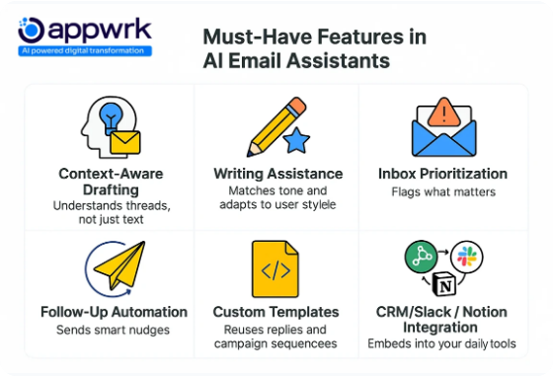
Email & Conversational AI
Smart Inbox Management Auto-categorize incoming messages by priority, urgency, and topic to keep critical conversations visible.
One-Click Smart Replies Generate contextual response drafts instantly to reduce response times and eliminate inbox clutter.
NLP & Speech Recognition Natural Language Processing and accurate Speech-to-Text turn voice notes into structured written text.

Slide 6
Grammarly & Style Optimization
Account Setup & Integration
Advanced Writing Insights
Deploy browser extensions, desktop applications, and document platform integrations to maintain real-time assistance everywhere you type.
Set custom audience formality and domain goals. Detect passive voice, eliminate wordiness, and optimize text for peak engagement.
CORE FEATURES
PRACTICAL APPLICATION
Instant grammar checks, spelling verification, plagiarism screening, and tone detection indicators.
Establish role-based preferences to align team writing with standardized corporate brand guidelines.

Slide 7
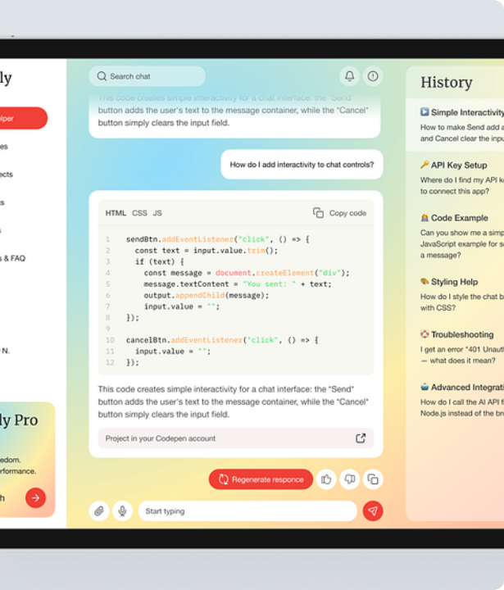
Customer AI Support
24/7 Automated Engagement
Deploy AI chatbots to resolve recurring FAQs, qualify prospective leads, and deliver rapid customer assistance around the clock.
Leverage sentiment analysis algorithms to measure customer emotion in real time and automatically escalate sensitive cases to human agents.

Slide 8






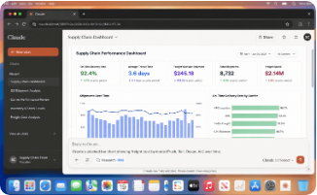
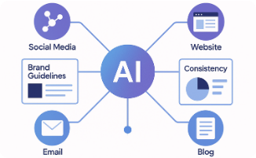
AI in Content Creation
1. Idea Generation
2. Draft Assistance
3. Automated Editing
Brainstorm fresh blog topics, creative headlines, and structured content outlines in seconds.
Generate comprehensive first drafts for articles, social posts, reports, and marketing emails.
Refine overall structure, enhance narrative flow, and boost audience engagement automatically.

Slide 9


Meetings & Collaboration
Live Transcription
Convert spoken meeting dialogue into highly accurate, searchable text transcripts in real time.
Action Item Extraction
AI automatically summarizes key decisions, highlights deadlines, and assigns responsibilities.
Seamless Translation
Break cross-border language barriers across global teams with instantaneous translation.

Slide 10
Best Practices & Ethics
Human Verification First: AI is an assistant—always verify facts, tone, and specific context before dispatching messages.
Maintain Authenticity: Use generative AI to enhance and polish your natural voice, not replace your personal perspective.
Protect Data Privacy: Avoid inputting confidential business metrics or personal identifiable information into public AI models.
Combine Judgment with Efficiency: Optimal communication stems from pairing AI speed with human critical thinking.

Slide 11


Core Business Impact
Transforming Enterprise Communication
70%
Inbox Time Saved
AI adoption across writing and communication channels converts tedious administrative tasks into streamlined automated workflows.
24/7
By pairing smart tools like Grammarly and NLP assistants with human oversight, teams achieve unmatched clarity, speed, and consistency.
Support Coverage

Slide 12
Questions & Discussion
Thank you for exploring AI in Communication. Ready to transform your daily writing workflows?

