Slide 1
AI for Office & Productivity
Master AI tools to work smarter, faster, and more efficiently
Munzurul Islam

Slide 2
What is AI?
What is AI?
Why It Matters
6 Hours of Training
Machines that learn from examples and make decisions
Save hours each week, write faster, make better decisions
Practical, beginner-friendly guidance with no experience needed
Munzurul Islam

Slide 3
Hour 1: How AI Actually Works
AI Learns From Examples
Trained on millions of examples, not fixed rules
Finds patterns to predict useful answers
More data helps it improve over time
AI You Already Use Every Day
Netflix: Recommends shows based on what you watch
Google Maps: Predicts traffic and fastest routes
Your phone: Face recognition, voice commands, predictive text
Munzurul Islam

Slide 4




How AI Learns: The Process
Four step process:
1. Data
2. Pattern Recognition
3. Learning
4. Prediction
AI studies examples from text, images, and behavior
It adjusts itself based on what it finds
It uses learned patterns to answer or recommend
It finds repeated signals and relationships
Munzurul Islam

Slide 5
HOUR 2
AI-Powered Productivity Tools
Google Gemini
ChatGPT
In Gmail, Docs, and Sheets.
Drafts emails, reports, and posts.
Munzurul Islam

Slide 6
HOUR 2
More AI Tools to Explore
01
02
Microsoft Copilot
Grammarly
Built into Word, Excel, PowerPoint, and Outlook
Fixes grammar and improves tone
03
04
Deep Seek
Notion AI
Fast AI for coding and analysis
Organize notes and generate summaries
Munzurul Islam

Slide 7
Getting Started: Step-by-Step Guides
Google Gemini
Open Gmail or Google Docs
Look for the "Gemini" button on the sidebar
Type your question in plain English
Gemini reads your context and gives instant answers
Munzurul Islam

Slide 8
ChatGPT: Step-by-Step Guide
Steps to get started with ChatGPT:
Go to openai.com → Sign up (free)
Type any question or task in the chat box
ChatGPT responds like a helpful colleague
Use it for writing, brainstorming, and learning
Munzurul Islam

Slide 9
HOUR 2
Microsoft Copilot: Step-by-Step Guide
1
2
In Word
In Excel
Click "Copilot" on the right side
Analyze data and create charts automatically
3
4
In PowerPoint
In Outlook
Generate full slides from your outline
Draft and summarize emails instantly
Munzurul Islam

Slide 10

Email Management with AI
Key benefits:
AI reads long email threads in seconds
Pulls out: who said what, deadlines, action items
Get a 3-sentence summary instead of scrolling
AI filters and labels emails automatically
Prioritizes urgent messages so you see them first
Munzurul Islam

Slide 11
HOUR 3 & 4
AI in Email & Communication
Before AI
After AI
30 minutes sorting 20 emails and missing deadlines.
AI summarizes your inbox in 2 minutes. Save 5–10 hours weekly.
Munzurul Islam

Slide 12
Practical Email Transformation
✏️ Your Rough Draft
✨ AI Polishes It
"hi, thanks for the update. we need to discuss timeline."
"Thank you for the update. I'd like to discuss the project timeline at your earliest convenience."
✅ Final Result
"Thank you for the update. I'd like to discuss the project timeline at your earliest convenience."
Takes 5 seconds instead of rewriting yourself.
Munzurul Islam

Slide 13

Smart Inbox Organization
How AI organizes your email:
AI filters and labels emails automatically
Prioritizes urgent messages so you see them first
Reduces inbox clutter and stress
Saves you 5-10 hours every week
Never miss important deadlines again
Munzurul Islam

Slide 14
Document Summarization in Action
📄 Document Summary Example
Long document → AI processing → Short summary
You upload: A 50-page research document or PDF
AI creates: A 1-page summary with key findings
Result: Stay informed without reading everything
Perfect for research reports, meeting notes, contracts, and proposals.
Munzurul Islam

Slide 15
HOUR 3 & 4
Summarizing Long Documents
How AI summarization works:
Upload a long PDF or document
AI creates a summary in seconds
Extract key points without reading everything
Perfect for research, reports, and meeting notes
Stay informed without spending hours reading
Munzurul Islam

Slide 16
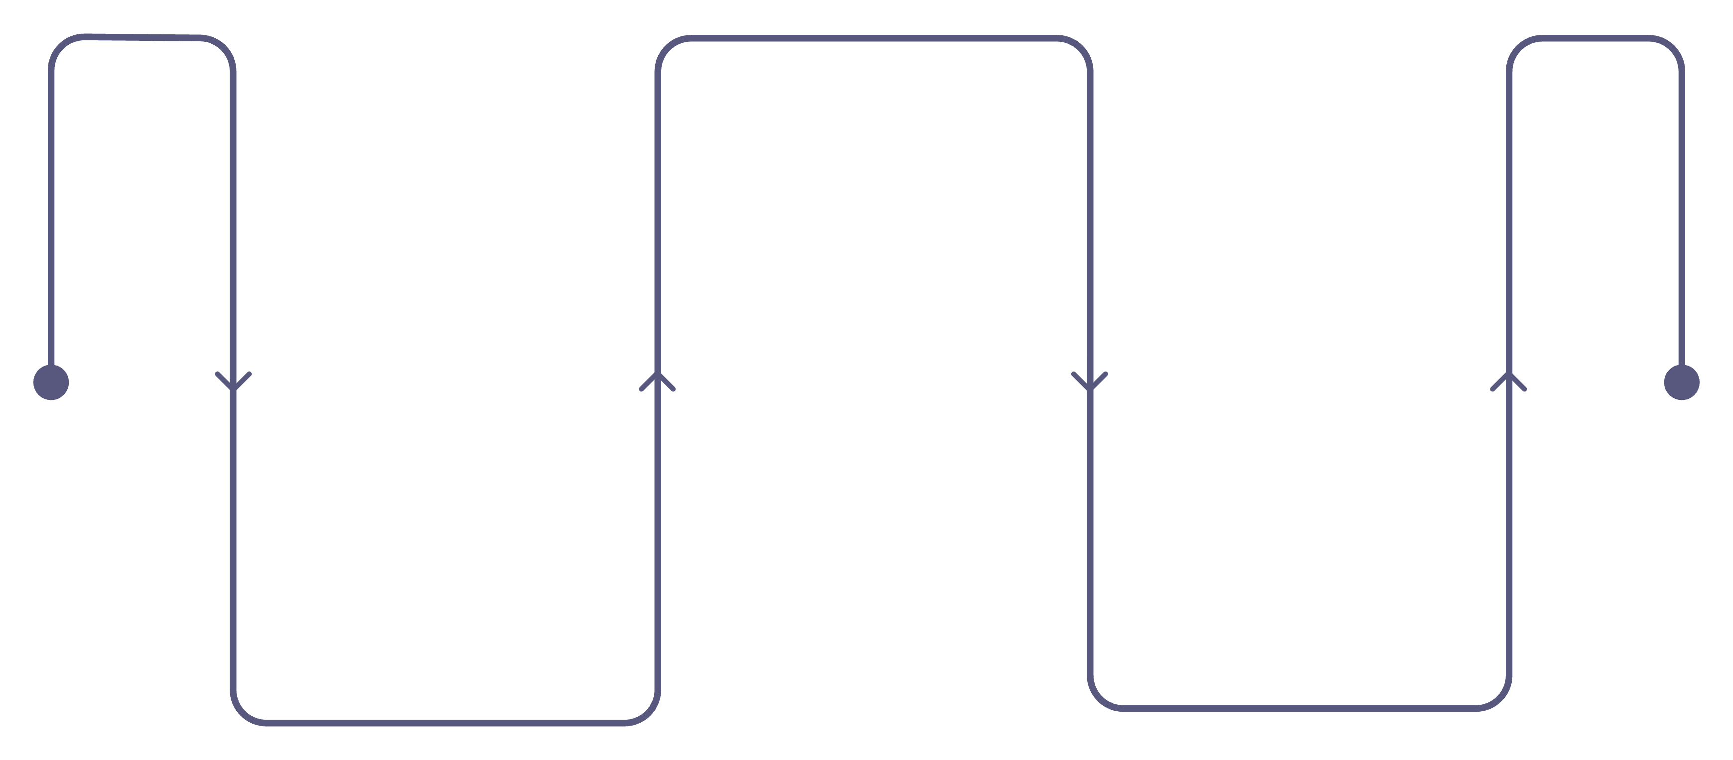
HOUR 5
AI for Writing & Summarization
AI Draft
Generate a full first draft
Edit & Personalize
Provide Topic
Share topic and key points
Refine voice and details
AI quickly turns your topic into a strong first draft.

Slide 17
Writing & Summarization in Action
📝 Blog Post Example
You provide: Topic + 3 key points
AI generates: Full draft
You edit and personalize: 15 mins vs. 2 hours
Munzurul Islam

Slide 18
Document Summarization Example
Real-world example:
You upload: A 50-page research document or PDF
AI creates: A 1-page summary with key findings
Result: Stay informed without reading everything
Perfect for research reports, meeting notes, contracts, and proposals.
Munzurul Islam

Slide 19

HOUR 6
Basic English: AI as Your Writing Coach
Grammar & Spelling
Tone Adjustment
AI English Tutor
Grammarly catches errors in emails, documents, and social media automatically as you type.
Make writing more professional, friendly, or casual with one instruction to your AI tool.
Ask AI to explain grammar rules simply, show correct sentence examples, and give instant writing feedback.
Munzurul Islam

Slide 20

Common Mistakes to Avoid
⚠️ Don't Trust AI 100%
🔒 Protect Sensitive Data
🤝 AI is a Helper, Not a Replacement
Always review important content before sending or publishing. AI can make mistakes — your judgment is still essential.
Never share confidential company information, client data, or passwords with public AI tools like ChatGPT or Gemini.
Use AI to boost your thinking and speed — not to replace your expertise, creativity, or professional judgment.
Munzurul Islam

Slide 21
Your Next Steps
You don't need to master everything at once. Start small, build confidence, and let AI work for you.
Pick One Tool This Week
Start With Simple Tasks
Experiment & Build Confidence
Choose Gemini, ChatGPT, or Copilot — whichever fits your daily workflow best.
Summarize an email, draft a short message, or ask AI to explain something you don't understand.
Try new tasks gradually. The more you use it, the more time and effort you'll save every day.
Notes:
Munzurul Islam

