Slide 1


AI in Daily Life
A guide across six powerful domains — Healthcare, Finance, Marketing, HR, Web Design, and English
lectures made by Munzurul Islam-Trainer (SEO EXPATE BANGLADESH LTD)
BEGINNER LEVEL
6 TOPICS · 6 HOURS
Munzurul Islam

Slide 2




HOUR 01
AI in Healthcare
Artificial Intelligence is reshaping modern medicine — from faster diagnosis to personalized treatment plans tailored to individual patients.
What is AI in Healthcare?
Core Applications
Using machine learning and algorithms to analyze medical data, diagnose diseases, and recommend treatments — with the key goal of improving patient outcomes and reducing errors.
Medical Imaging
Analyzes CT scans, MRIs, and X-rays to detect tumors, fractures, and abnormalities
AI systems can detect cancer in X-rays faster than radiologists with 95%+ accuracy.
Disease Detection
Identifies early signs of diabetes, heart disease, and Alzheimer's from patient data
Drug Discovery
Reduces development time from 10+ years to just 2–3 years
IBM Watson for Oncology — Real-World Example
Personalized Medicine
IBM's Watson for Oncology analyzes millions of medical records to help doctors choose the most effective cancer treatment plans — combining speed and breadth no individual physician can match.
AI analyzes a patient's genetic makeup to recommend medicines tailored specifically to them — preventing adverse drug reactions and significantly improving treatment success rates.
Challenges & The Road Ahead
⚠️ Data Privacy
⚖️ Ethics & Bias
🚀 Future Outlook
Patient data must be protected under strict regulations like HIPAA and GDPR
AI must not discriminate against patient groups based on race, gender, or income
AI-powered surgical robots, predictive health monitors, and virtual health assistants
Munzurul Islam

Slide 3

HOUR 02
AI in Finance
From preventing fraud in milliseconds to managing your investments automatically — AI has become the backbone of modern financial services.
99%
$B
2M+
Fraud Caught
Saved Annually
Transactions/sec
Modern AI systems detect fraudulent transactions while minimizing false alarms
Banks save billions each year by automating processes and preventing fraud
AI monitors millions of transactions per second for suspicious patterns
Fraud Detection & Security
Credit Risk & Loan Decisions
How it works: If you suddenly buy items in another country, AI flags it as potential fraud within milliseconds — analyzing location, spending patterns, and transaction history simultaneously.
01
Algorithmic Trading
Data Collection
AI analyzes market data and executes trades faster than any human — operating in microseconds. Robo-advisors like Betterment use AI to manage investments for millions of users automatically, based on risk tolerance and personal goals.
AI gathers payment history, income records, and spending behavior
02
Risk Assessment
Algorithms calculate the probability of loan default within seconds
03
Instant Decision
Loan approvals that once took days now happen in minutes
AI must be transparent — lenders are legally required to explain why a loan was denied.
Munzurul Islam

Slide 4
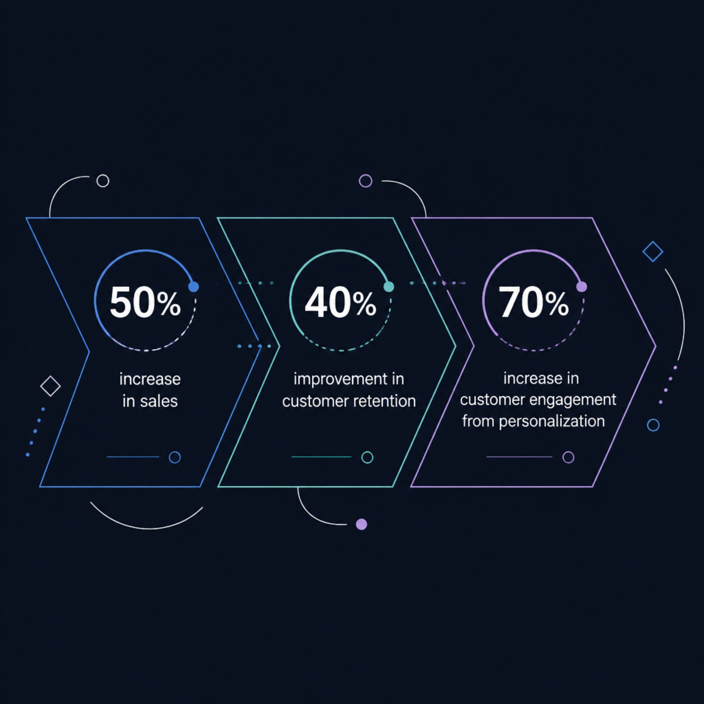




HOUR 03
AI in Marketing
AI helps companies understand customers better, deliver personalized experiences, and optimize every step of the marketing funnel.
Why AI Marketing Works
Companies using AI-powered marketing consistently report dramatic improvements across all key metrics — because AI can process and act on customer data at a scale and speed that no human team can match.
Netflix & Amazon — Real Examples
Netflix recommends shows based on your exact viewing patterns. Amazon suggests products you're statistically likely to buy next — both powered by deep learning recommendation engines analyzing billions of data points.
Personalized experiences increase customer engagement by 70% on average.
Customer Segmentation
Predictive Analytics
AI Chatbots
AI analyzes browsing history, purchases, and preferences to deliver unique content to each individual visitor
AI forecasts which customers will buy, churn, or respond — enabling proactive discounts before a customer leaves
Handle inquiries 24/7, reduce service costs by 30%, and escalate complex issues to human agents automatically
Munzurul Islam

Slide 5

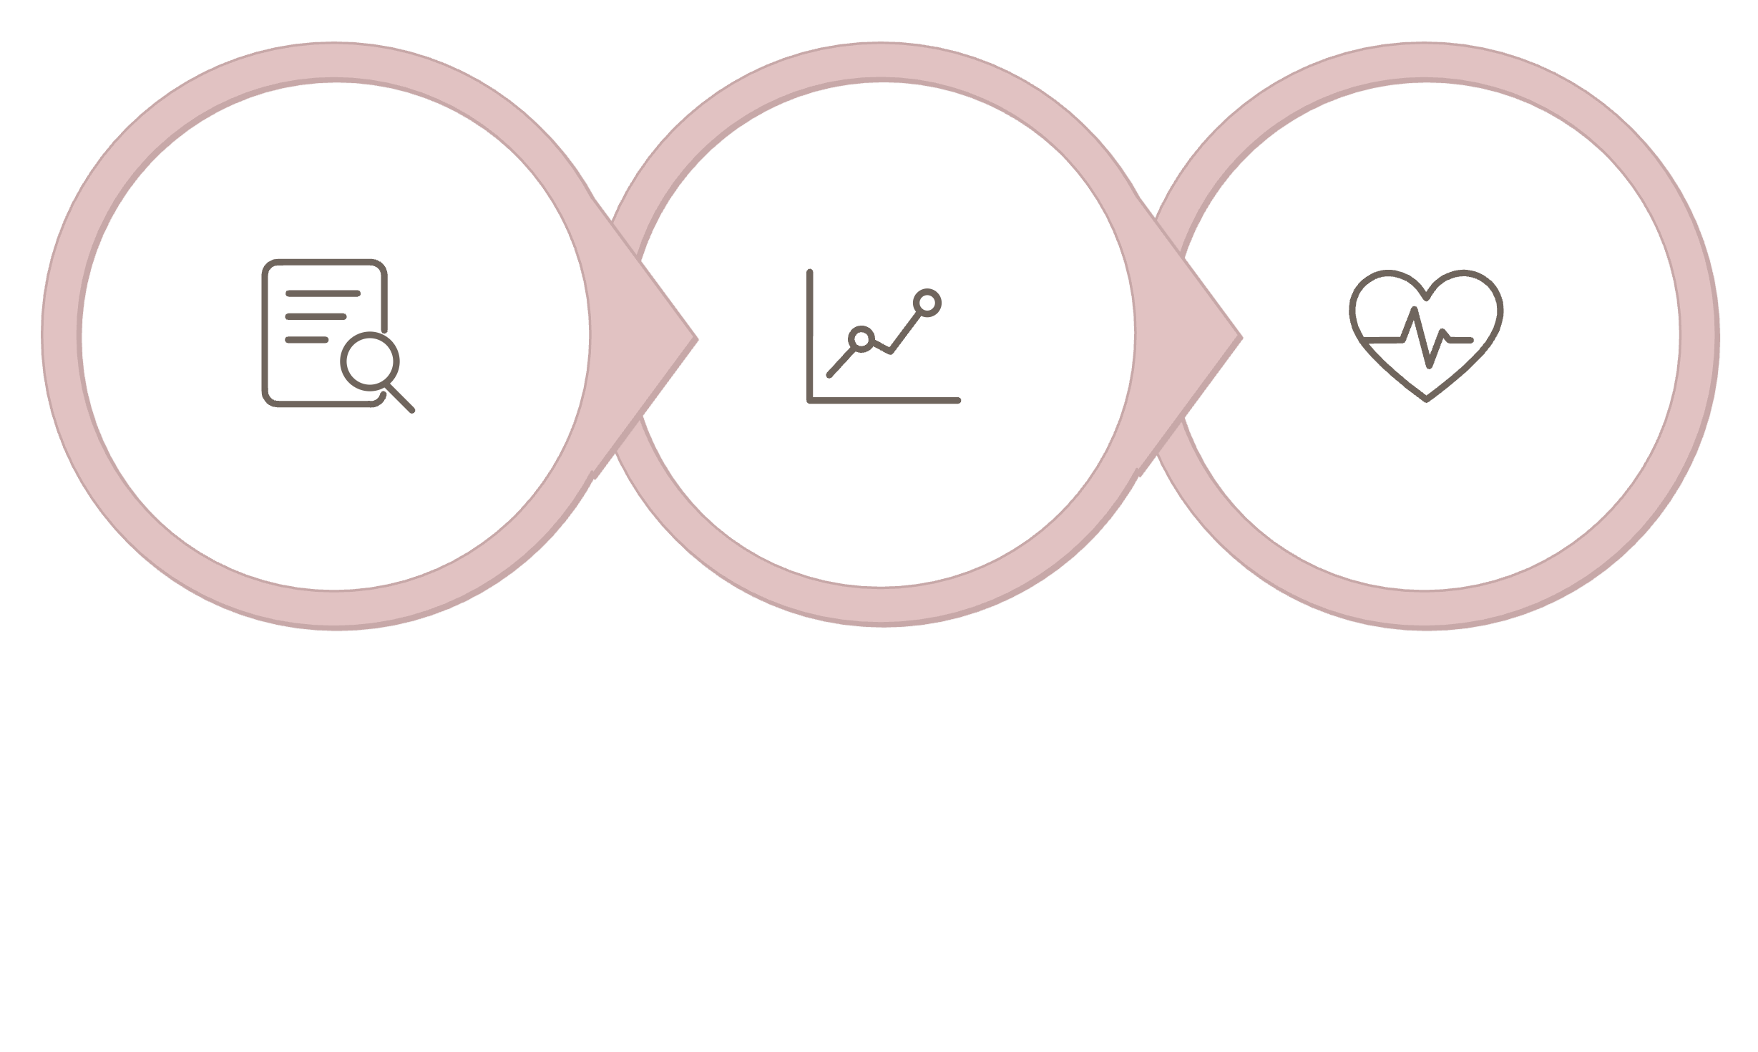


HOUR 04
AI in HR Recruitment
AI is transforming how companies find, assess, and retain talent — but it also raises important questions about fairness and ethics that every beginner should understand.
Capabilities & Concerns
The Recruitment Revolution
Google uses AI to screen 2 million resumes annually — identifying the best-fit candidates from an otherwise unmanageable volume of applications. What once took HR teams weeks now takes minutes.
✅ Resume Screening
Reads, extracts skills, and matches candidates to requirements automatically
✅ Video Interview Analysis
Some systems analyze facial expressions and tone — speeds up review but raises privacy concerns
⚠️ Bias Risk
Poorly designed AI has discriminated against women and minorities — careful auditing is essential
Resume Screening
Predictive Assessment
Retention Monitoring
🎓 Personalized Learning
AI recommends training courses based on individual career goals and skill gaps
This end-to-end AI pipeline reduces hiring time from months to weeks while improving the overall quality of candidates selected.
Ethical Note: AI hiring tools must be regularly audited to ensure they do not perpetuate systemic bias in the workplace.
Munzurul Islam

Slide 6



HOUR 05
AI in Web Design
AI is giving designers superpowers — automating repetitive tasks, personalizing user experiences, and building entire websites in minutes.
Describe
Generate
Tell AI your business type, goals, and style preferences
AI auto-arranges layout, typography, color palette, and spacing
Optimize
Improve
AI tests variants and personalizes content per visitor
AI learns from user behavior to continuously enhance the site
Key Tools & Real Examples
Accessibility & Future Trends
Canva & Adobe Firefly: AI suggests layouts and design elements from your content
Wix ADI: Creates entire websites in minutes based on a simple business description
Heat Mapping: AI tracks where users click and scroll to surface design improvements
Dynamic Content: Websites adapt based on visitor location, device, and past behavior
Auto Alt Text
Voice UI Navigation
AI generates image descriptions for visually impaired users automatically
AI enables voice-controlled browsing for improved accessibility
Adaptive Websites
Future sites will learn from every interaction and self-improve continuously
Personalized websites increase conversion rates by 20–30%.
Munzurul Islam

Slide 7







HOUR 06
Basic English Fundamentals
Strong English skills open doors in every career — especially in technology fields where clear communication is as important as technical knowledge.
Grammar Building Blocks
Tenses at a Glance
Part of Speech
Role & Example
Professional Phrases
Noun
Person, place, or thing — "AI improves healthcare"
"In my opinion," / "According to," — express views formally
"Furthermore," / "In conclusion," — connect and close ideas
Use "use" instead of "utilize"; "help" instead of "facilitate"
Verb
Action word — "analyzes," "detects," "improves"
Adjective
Describes a noun — "accurate," "fast," "complex"
Adverb
Modifies a verb — "quickly," "automatically"
Core sentence structure: Subject + Verb + Object
Example: "AI improves healthcare outcomes."
Present
Past
Future
"AI analyzes data every second"
"AI detected the fraud immediately"
"AI will transform all industries"
Common Mistakes & How to Improve
Subject-Verb Agreement
Read Aloud Daily
He go to work → He goes to work
Hearing your own writing reveals unnatural phrasing and errors
Use Grammar Tools
Practice with Natives
Grammarly and similar tools catch mistakes and explain corrections
Consistent exposure to native speakers accelerates fluency and confidence
Munzurul Islam

Slide 8







Key Takeaways
Six domains, one unifying truth: AI is not replacing humans — it is amplifying what humans can do.
Healthcare
Finance
AI diagnoses faster, discovers drugs quicker, and personalizes treatment — saving lives at scale
Fraud caught in milliseconds, loans approved in minutes, investments managed automatically
Marketing
HR & Recruitment
Personalized experiences, predictive analytics, and 24/7 chatbots drive revenue growth
Faster hiring, better candidate matching — but ethical AI design is non-negotiable
Web Design
Basic English
AI builds, optimizes, and adapts websites — freeing designers for creative work
Clear grammar, professional phrases, and daily practice unlock communication in every field
"The goal of AI is not to replace human intelligence — it is to amplify it, making each of us more capable than we could ever be alone."
KEEP PRACTICING. KEEP LEARNING. AI IS A TOOL — AND YOU ARE THE ONE WHO WIELDS IT.
Munzurul Islam

