Slide 1
AI in Daily Life
Duration
01
6 hours of detailed lecture content — 30 minutes per topic
Hour 01
AI for Shopping & Personal Finance
02
Objective
Hour 02
Understand practical AI applications in everyday scenarios with real-world examples and ethical grounding
AI Tools and Frameworks
03
Hour 03
AI in Healthcare and Robotics
04
Hour 04
Understanding Bias in AI
05
Hour 05
Robotics and AI Integration
06
Hour 06
Comprehensive Review & Practical Applications
Munzurul Islam- Trainer

Slide 2







HOUR 01 — 30 MINUTES
AI for Shopping & Personal Finance
Definition: AI shopping refers to using artificial intelligence technologies to enhance the shopping experience, automate purchasing decisions, and optimize personal financial management. It transforms your smartphone into a digital personal assistant that handles research, price tracking, and checkout processes.
Key Applications in Shopping
Personalized Recommendations
Price Tracking & Comparison
AI analyzes your browsing history, purchase patterns, and preferences to suggest products you're likely to buy. Amazon's recommendation engine suggests items based on items you've viewed and purchased before, increasing sales by up to 35%.
AI tools monitor price fluctuations across multiple retailers in real-time. The system alerts you when the price drops below your target price. This can save consumers 15–30% on purchases.
Agentic Commerce
Visual Search
Advanced AI agents can autonomously navigate retail websites, find the best prices, compare specifications, and even complete checkout on your behalf with your permission. This is the next frontier in AI shopping.
Upload a photo of an item you like, and AI finds similar products available for purchase. Particularly useful for fashion and home décor shopping.
AI in Personal Finance
According to Experian's 2024 report, 67% of Gen Z and 62% of millennials use AI for personal finance tasks, with 98% reporting positive experiences.
Budgeting & Savings
Investment Planning
AI chatbots like ChatGPT help create personalized budgets by analyzing your spending patterns. They identify areas where you overspend and suggest realistic savings targets. Example: An AI system might notice you spend $200/month on subscriptions and recommend canceling unused services.
AI tools analyze market trends and your risk tolerance to suggest investment strategies. 48% of users report using AI for investment planning decisions.
Credit Score Improvement
Expense Tracking
AI provides actionable steps to improve credit scores — analyzing your credit report and recommending specific actions like paying down high-interest debt or disputing errors. 48% of users have used AI for this purpose.
AI automatically categorizes transactions and identifies spending patterns. It can alert you when you're approaching budget limits in specific categories.
Benefits
Important Risks: AI can hallucinate or provide inaccurate information. Financial advisors emphasize that AI should be a starting point, not your only resource. Always verify important financial decisions with human experts. AI systems may have biases in recommendations based on their training data.
Time savings: Users report 5–10 hours saved monthly
Cost reduction: 15–30% savings on purchases
Accessibility: Free tools widely available
Simplification: Complex financial tasks made manageable
Practical Tips for Safe AI Shopping
Verify Before You Buy
Use Budgets as Guidelines
Always verify AI recommendations with multiple sources before making large purchases.
AI-generated budgets are helpful guides, not absolute rules — adjust based on your personal circumstances.
Set Transaction Limits
Seek Professional Advice
Enable transaction limits on AI shopping agents to prevent large unauthorized purchases.
Review AI recommendations for investment advice with a certified financial advisor. AI assists — it does not replace — professional guidance.
Munzurul Islam- Trainer

Slide 3
HOUR 02 — 30 MINUTES
AI Tools and Frameworks
Definition: AI tools and frameworks are software libraries and platforms that provide pre-built functions, algorithms, and models to help developers build AI applications without starting from scratch. They abstract complex mathematical operations into simple, usable functions.
Why Do We Need Frameworks?
Complexity Reduction
Speed to Market
Building AI from scratch requires deep knowledge of linear algebra, calculus, and statistics. Frameworks handle this complexity, allowing developers to focus on solving problems.
Pre-built components accelerate development. What might take months to build from scratch can be accomplished in weeks using frameworks.
Community Support
Optimization
Popular frameworks have large communities providing tutorials, solutions to common problems, and continuous improvements.
Frameworks are optimized for performance on different hardware — CPUs, GPUs, and specialized processors.
Major AI Frameworks for Beginners
Framework
Primary Use
Real-World Example
Best For
Scikit-learn
Traditional machine learning
A bank classifies loan applications as "approve" or "deny" using applicant income, credit score, and employment history
Beginners; excellent documentation
PyTorch
Deep learning & neural networks
Meta uses PyTorch to power recommendation systems on Facebook and Instagram
Research; flexible & intuitive design
TensorFlow
Deep learning, production deployment
Google Translate — translating text across 100+ languages
Production systems; mobile & edge deployment
FastAI
Simplified deep learning
A farmer builds a model that identifies crop diseases from photos in just 5 lines of code
Fastest entry point to deep learning
PyCaret
Automated Machine Learning (AutoML)
A startup builds a customer churn prediction model without hiring specialized data scientists
Rapid prototyping; 20 lines of code to deployment
How to Choose a Framework
Beginners
Rapid Prototyping
Start with scikit-learn for traditional ML or FastAI for deep learning
Use PyCaret to quickly test ideas and compare multiple models
Research
Production
PyTorch is the preferred choice in academia
Use TensorFlow or PyTorch depending on your deployment needs
Core Concepts Every Trainee Must Know
Training Data
Prediction
Model
Accuracy
Munzurul Islam- Trainer

Slide 4
HOUR 03 — 30 MINUTES
AI in Healthcare and Robotics
Overview: AI is revolutionizing healthcare by improving diagnosis accuracy, accelerating drug discovery, and enabling personalized treatment plans. The global healthcare AI market is growing at 40% annually.
Diagnostic AI: Key Stats
Diagnostic AI Systems
94.5%
Medical Imaging Analysis: AI algorithms analyze X-rays, MRIs, and CT scans to detect diseases like cancer, pneumonia, and heart conditions. Studies show AI can match or exceed radiologist accuracy in detecting certain cancers.
Pathology Analysis: AI examines tissue samples to identify diseases — faster and more consistent than manual analysis by pathologists.
Symptom Checkers: AI chatbots ask targeted questions about symptoms and suggest possible conditions. Important: these guide you, they do not replace doctors.
AI Mammogram Accuracy
vs. 88% for human radiologists
40%
Annual Market Growth
Global healthcare AI market expansion
1M+
Hospital Deliveries
Moxi robots across 25+ hospitals
Robotic Surgery & Assistance
Surgical Robots (da Vinci System)
Autonomous Ultrasound (2026)
The surgeon controls the robot from a console, and the robot translates their movements into precise surgical actions. Benefits: smaller incisions, less blood loss, faster recovery times.
Robotic ultrasound systems with AI can autonomously locate tumors with an 84% success rate in 5.75 seconds. AI identifies the target; geometric algorithms position the probe correctly.
Hospital Logistics — Moxi Robot
Therapeutic & Emotional Support
Moxi from Diligent Robotics transports medications, lab samples, and supplies between departments. Over 1 million deliveries in 25+ hospitals — returning hundreds of thousands of hours to clinicians for patient care.
Robin — a 4-foot-tall robot that sounds like a 7-year-old girl — is deployed in children's hospitals to reduce fear and loneliness. It remembers individual patients and asks about their progress.
Munzurul Islam- Trainer

Slide 5

HOUR 03 — 30 MINUTES
AI for Drug Discovery
High-Throughput Screening
Traditional Discovery
AI-Powered Analysis
Clinical Candidate Match
Years of molecular analysis
Test millions of combinations
Months to identify leads
Aligns molecules with trials
AI analyzes millions of molecular combinations to identify promising drug candidates. A process that traditionally took years now takes months. AI also identifies patients who are strong candidates for specific clinical trials, accelerating research timelines significantly.
Important Limitations & Ethical Considerations
AI is a Tool, Not a Replacement
Data Privacy
AI assists doctors but never replaces human judgment. Doctors must understand and approve all AI recommendations before acting on them.
Healthcare AI requires sensitive patient data. Strict regulations — including HIPAA in the US — protect this data and govern its use.
Bias in Healthcare AI
Regulatory Approval
If training data comes from biased sources, AI can perpetuate healthcare disparities. This is explored in depth in Hour 04.
Healthcare AI systems must undergo rigorous testing and regulatory approval before any clinical use. No shortcuts are acceptable in this domain.
Munzurul Islam- Trainer

Slide 6



HOUR 04 — 30 MINUTES
Understanding Bias in AI
Definition: Bias in AI refers to systematic errors or unfair outcomes that AI systems produce, often disadvantaging certain groups of people. Unlike human bias — which is individual — AI bias is systematic and affects many people consistently.
The Four Types of AI Bias
1. Historical / Representational
2. Selection / Measurement
Training data reflects historical inequalities and discrimination.
Example: A hiring AI trained on historical data learns to discriminate against women because fewer women were hired in tech roles historically — and perpetuates this pattern.
The data collected is incomplete or doesn't accurately measure what we want to measure.
Example: A healthcare algorithm trained primarily on data from wealthy hospitals may not work well for patients from underserved communities.
3. Algorithmic / Optimization
4. Feedback / Emergent
The algorithm itself — even with unbiased data — can produce biased outcomes.
Example: An algorithm optimizing for "profit" in lending might systematically deny loans to certain neighborhoods, even if individual applicants are qualified.
Bias emerges over time as the system learns from its own decisions.
Example: A criminal justice AI recommends more police patrols in certain neighborhoods → more arrests → reinforces the original bias. A vicious cycle.
Real-World Case Studies
Case Study 1: Healthcare Algorithm Racial Bias (2019)
Case Study 2: Facial Recognition Bias
A widely-used algorithm identified patients needing extra care but showed significant racial bias. At the same risk score, Black patients were considerably sicker than White patients. Why? The algorithm predicted healthcare costs, not actual health needs. Because of unequal access to care, less money is spent on Black patients with the same health needs — so the algorithm falsely concluded they were healthier.
Facial recognition systems trained primarily on light-skinned faces show dramatically unequal error rates:
Fixing this bias would increase Black patients receiving additional help from 17.7% to 46.5% — a life-changing difference.
Why Bias Matters & How to Fix It
34%
0.8%
Why It Matters
Individual Impact: People are denied jobs, loans, healthcare, and opportunities based on biased AI decisions
Systemic Impact: Biased AI amplifies existing inequalities across society
Legal Impact: Biased AI can violate anti-discrimination laws
Trust Impact: Biased AI erodes public confidence in AI systems
Mitigation Strategies
Error Rate
Error Rate
Dark-skinned women
Light-skinned men
Diverse Training Data: Ensure training data represents all demographic groups
Fairness-Aware Modeling: Test models separately for each demographic group
Bias Auditing: Regularly test deployed AI systems for bias
Transparency: If an AI denies you a loan, you should be able to understand why
Human Oversight: AI should assist, not replace, human judgment in high-stakes decisions
Diverse Teams: Diverse perspectives catch biases that homogeneous teams miss
This bias has led to wrongful arrests of innocent people, disproportionately affecting Black men.
Bias in AI is not a technical problem alone — it's a socio-technical problem requiring diverse teams, diverse data, diverse perspectives, and ongoing vigilance. As AI becomes more powerful, addressing bias becomes more critical.
Munzurul Islam- Trainer

Slide 7




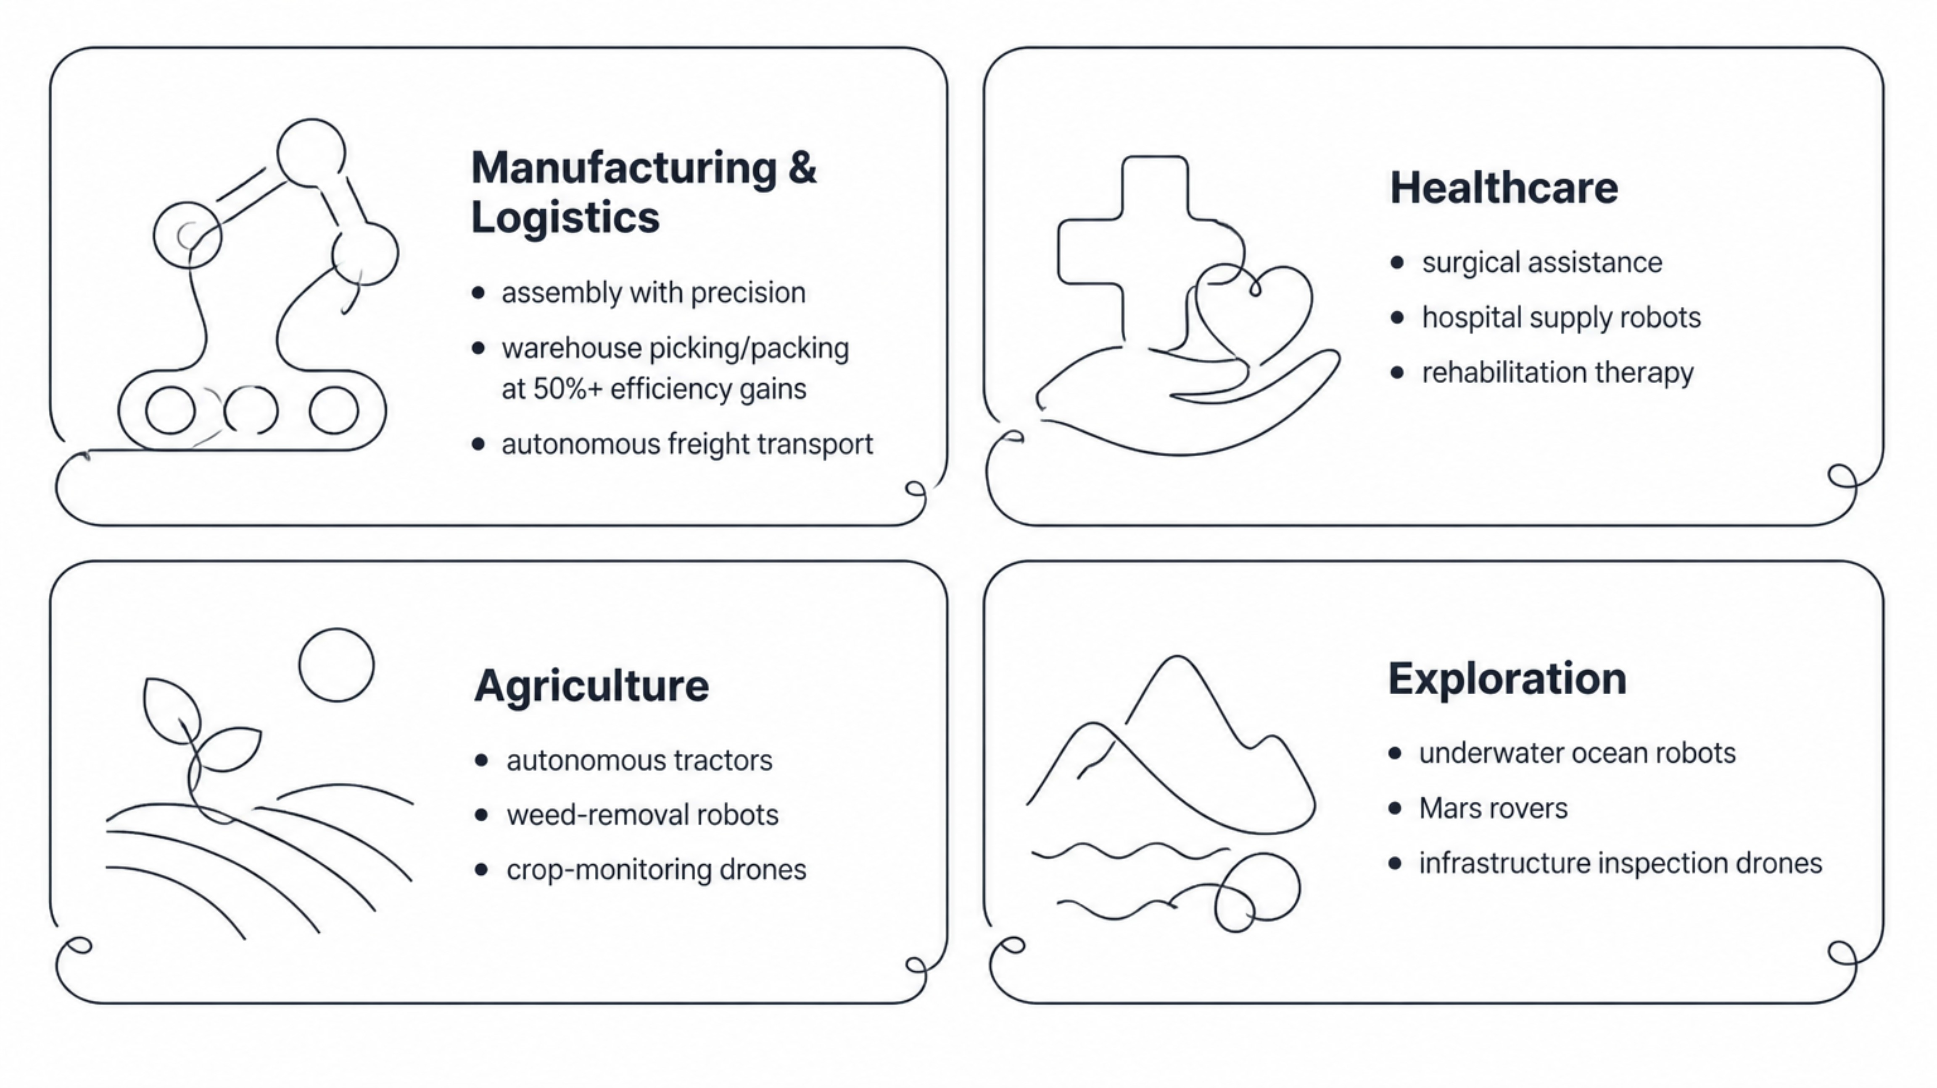
HOUR 05 — 30 MINUTES
Robotics and AI Integration
Definition: Robotics is the field of engineering and computer science that designs, builds, and programs machines (robots) to perform tasks autonomously or semi-autonomously. When combined with AI, robots can perceive their environment, make decisions, and act intelligently.
The Three Pillars of Intelligent Robots
2. Cognition (Decision-Making)
3. Control (Output/Action)
1. Perception (Input)
The robot's ability to understand the situation and decide what to do. Large Language Models (LLMs) enable robots to understand natural language commands. Example: "Pick up the red cup and place it on the table" → broken into sub-tasks: locate, grasp, move, release. Challenge: Handling ambiguity and unexpected situations.
The robot's ability to execute actions in the physical world via motors, actuators, and mechanical systems. AI learns optimal movement patterns — for example, grasping objects of different shapes without dropping them. Challenge: Physical systems have inertia, friction, and unpredictability.
The robot's ability to sense and understand its environment using cameras, LiDAR, ultrasonic sensors, thermal cameras, and microphones. Deep learning processes sensor data to identify objects and detect obstacles. Challenge: Real-world environments are messy and unpredictable.
Types of Robots & Real-World Examples
Mobile Robots
Manipulator Robots
Humanoid Robots
Purpose: Navigate and move through environments — delivery robots, warehouse robots, autonomous vehicles, quadrupeds.
AI Challenge: Localization, mapping, path planning, and obstacle avoidance.
Example: Boston Dynamics' Spot navigates complex terrain, climbs stairs, and opens doors using AI-powered perception and control.
Purpose: Perform precise tasks with arms and hands — industrial robots, surgical robots, humanoid robots.
AI Challenge: Grasping objects without breaking them, dexterity, and task planning.
Example: Gemini Robotics (2026) can fold origami, play cards, and perform complex manipulation tasks by learning from demonstrations.
Purpose: Mimic human form and capabilities — Tesla Bot, Boston Dynamics Atlas, Honda Asimo.
AI Challenge: Balance, coordination, and understanding human environments designed for humans.
Applications Across Industries
Munzurul Islam- Trainer

Slide 8
HOUR 05 — 30 MINUTES
Current Challenges & The Future
Current limitations and future directions for robotics AI.
Current Challenges
The Future of Robotics AI
Sim-to-Real Gap: Robots trained in simulation often fail in the real world due to unpredictable factors
Generalization: A robot trained to grasp red cups may fail with blue cups
Safety: Unexpected robot behavior near humans could cause injury
Cost: Advanced robots are expensive, limiting adoption
Fragility: Current AI-controlled robots are sensitive to prompt specification and exhibit non-deterministic behavior
Generalist Robots: Future robots will learn new tasks quickly rather than being trained for one specific task
Human-Robot Collaboration: Robots handle physical tasks; humans provide judgment and oversight
Embodied AI: Models like Gemini Robotics enable robots to interact with the physical world more naturally
Swarm Robotics: Multiple robots coordinating to accomplish complex tasks
9
Munzurul Islam- Trainer

Slide 9
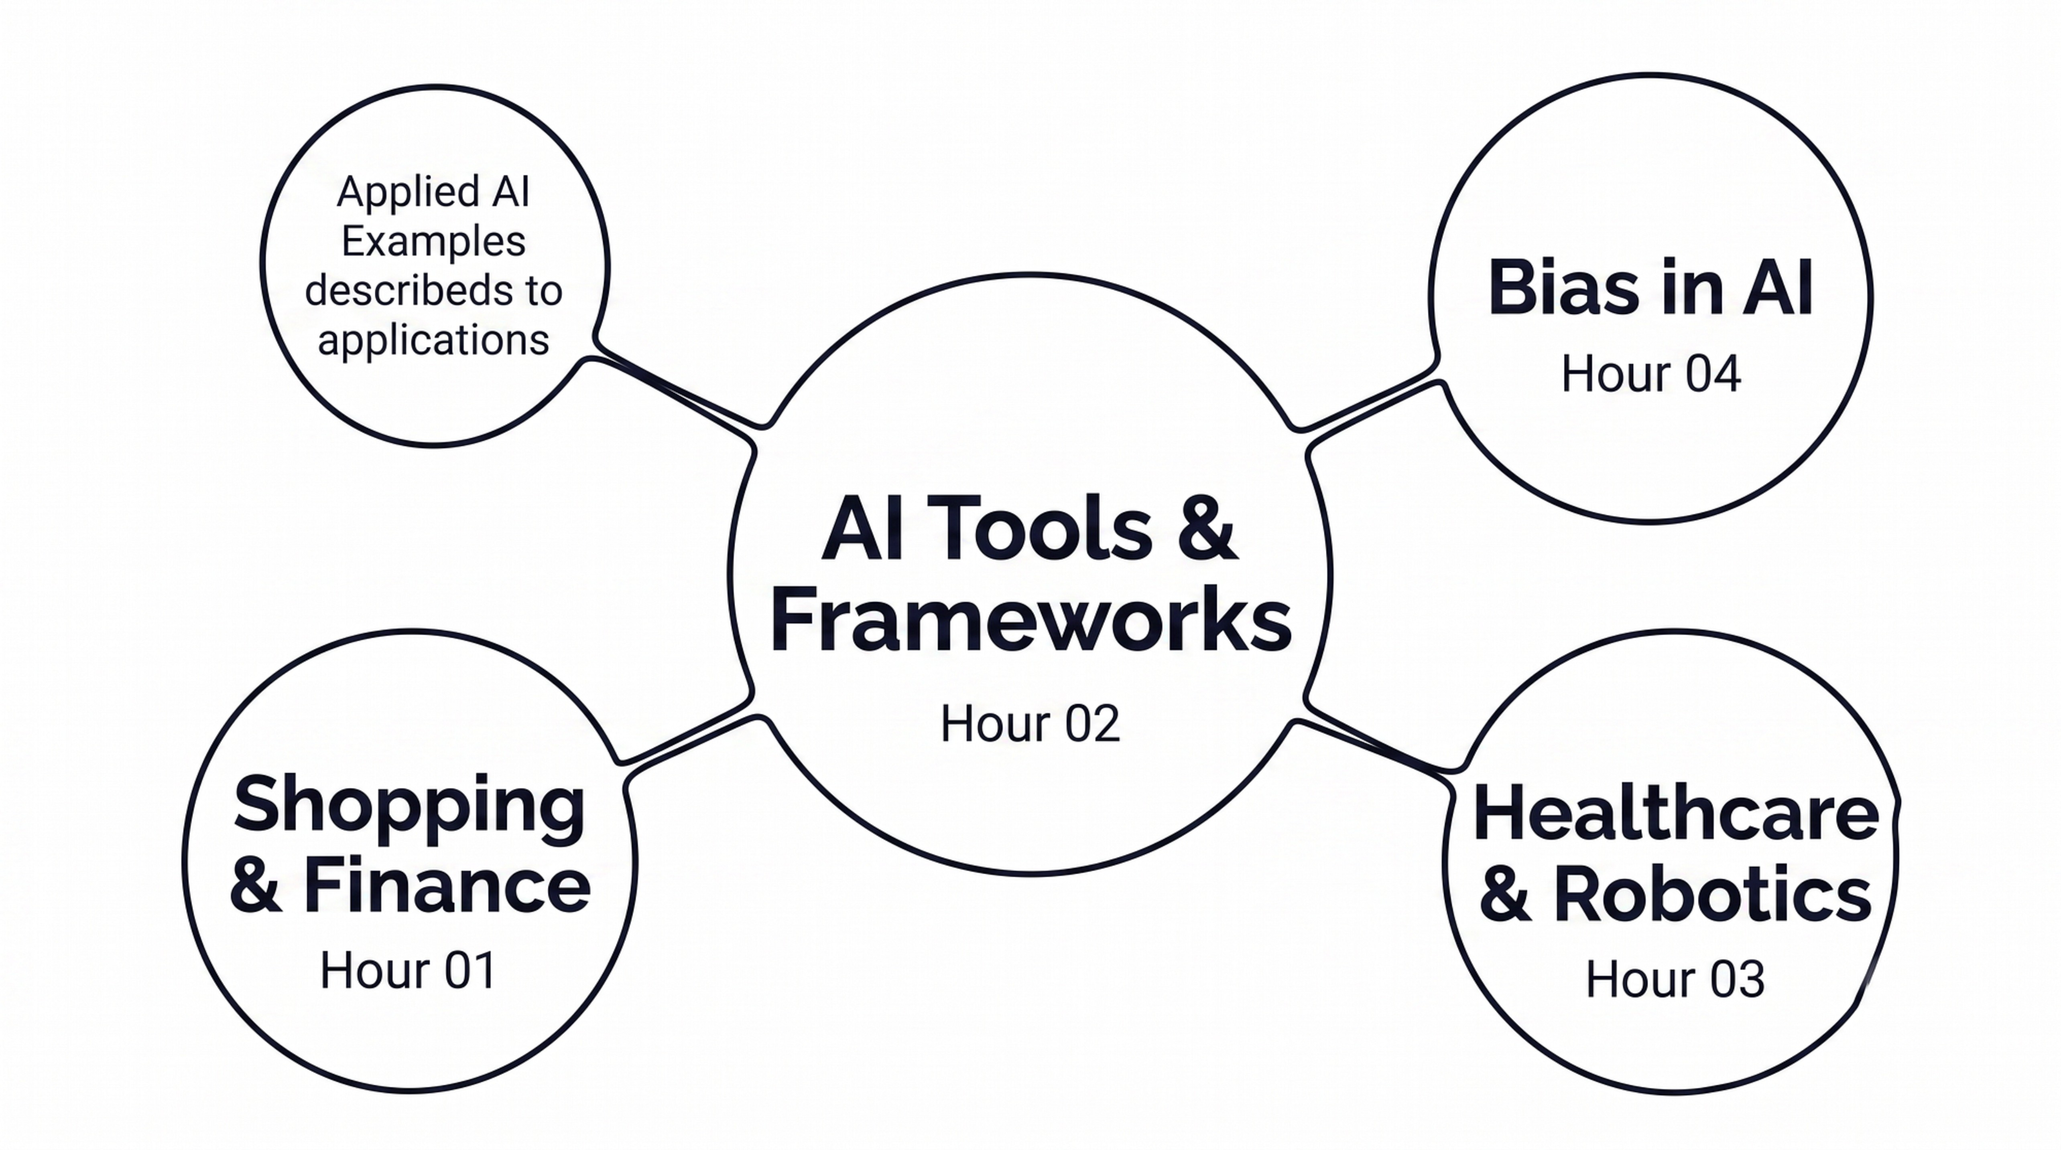
HOUR 06 — 30 MINUTES
Comprehensive Review & Practical Applications
This final session connects all five hours of content, reinforces core concepts, and applies them through practical exercises and ethical reflection.
How the Topics Connect
Core Concepts Glossary
Machine Learning
Deep Learning
Teaching computers to learn from data rather than explicitly programming them. The computer identifies patterns in data and uses those patterns to make predictions.
A subset of machine learning using neural networks inspired by the human brain. Excellent for complex tasks like image recognition and natural language understanding.
10
Munzurul Islam- Trainer

Slide 10
HOUR 06 — 30 MINUTES
Core Concepts & Practical Exercises
Core concepts followed by applied exercises.
Training
Inference
The process of feeding data to an AI model so it learns patterns. Requires quality data, appropriate algorithms, and careful tuning.
Using a trained model to make predictions on new data. This is what happens when you actually use an AI system in practice.
Practical Exercises
Exercise 1: Identify the Bias
Exercise 2: Choose the Right Tool
A company uses AI to screen job applications. The AI rejects 80% of applications from women but only 20% from men — even though women applicants have similar qualifications. What type of bias is this? How would you fix it?
Answer: This is historical/representational bias. The training data likely came from a company with a history of hiring more men. Fix: audit training data for gender representation, retrain with balanced data, and test the model separately for men and women to ensure equal performance.
You want to predict house prices based on features like size, location, and age. Which framework would you use? Why?
Answer: Scikit-learn is appropriate. This is a regression problem (predicting a continuous value) with structured data. Scikit-learn has excellent regression algorithms and is easy to learn for beginners.
11
Munzurul Islam- Trainer

Slide 11
HOUR 06 — 30 MINUTES
Exercise 3: Identify AI in Your Daily Life
List 5 AI applications you use. For each, identify: (a) What data does it use? (b) What decision does it make? (c) What could go wrong?
Application | Data Used | Decision Made | What Could Go Wrong
Netflix Recommendations | Viewing history & ratings | Predicts what you'll enjoy watching | Could recommend inappropriate content
Google Maps | Location, speed, traffic data | Predicts travel time & optimal route | Could be inaccurate during unusual events
Email Spam Filter | Email content & sender history | Classifies as spam or not spam | Could filter legitimate emails (false positive)
Exercise 3 Prompt
List 5 AI applications you use. For each, identify: (a) What data does it use? (b) What decision does it make? (c) What could go wrong?
12
Munzurul Islam- Trainer

Slide 12
HOUR 06 — 30 MINUTES
Ethical Principles for AI Professionals
Core principles for responsible AI practice.
Transparency
Fairness
Users should understand how AI systems make decisions that affect them. Black-box decisions in high-stakes domains are unacceptable.
AI systems should treat all groups equitably. Test models across demographic groups before deployment.
Accountability
Privacy
Someone must be responsible when AI systems cause harm. Responsibility cannot be diffused away by complexity.
User data must be protected and used only for stated purposes. Consent and data minimization are essential.
13
Munzurul Islam- Trainer

Slide 13
HOUR 06 — 30 MINUTES
Future Trends to Watch
Emerging directions highlighted in the course.
Multimodal AI
Systems that understand text, images, audio, and video together — e.g., Gemini analyzing a photo and answering questions about it
Agentic AI
AI that autonomously plans and executes complex tasks — e.g., shopping agents completing entire purchases without human intervention
Embodied AI
AI designed specifically for robots and physical interaction with the world — Gemini Robotics as a leading example
Explainable AI
Systems that explain their decisions in human-understandable terms — critical for trust in high-stakes domains
Federated Learning
Training AI models on distributed data without centralizing sensitive information — privacy-preserving by design
AI is a powerful tool — not magic. It requires quality data, thoughtful design, and human oversight. The most successful AI professionals combine technical skills with ethical awareness and a commitment to building AI systems that benefit everyone, not just a privileged few.
14
Munzurul Islam- Trainer

