Slide 1
AI Training Workshop
Introduction to Artificial Intelligence
A comprehensive training journey covering AI fundamentals, history, milestones, key concepts, and practical prompt skills — designed for 25 trainees.
Munzurul Islam

Slide 2




MODULE 1
Definition of Artificial Intelligence
Artificial Intelligence (AI) is the simulation of human intelligence processes by computer systems. These processes include learning (acquiring information and rules), reasoning (using rules to reach conclusions), and self-correction.
AI enables machines to perform tasks that typically require human intelligence — such as recognizing speech, making decisions, translating languages, and identifying patterns in large amounts of data.
Key Characteristics of AI
1
Learns from data and past experience
2
Adapts its behavior over time
3
Performs tasks without explicit step-by-step instructions
4
Mimics cognitive functions like problem-solving and learning
Munzurul Islam

Slide 3
Brief History of AI Development
1950s
1980s–90s
The Birth of AI: Alan Turing proposes the "Turing Test" in 1950. The term "Artificial Intelligence" is coined by John McCarthy at the Dartmouth Conference in 1956, marking the formal start of AI as a field.
Expert Systems & Revival: Rule-based expert systems gained traction in business. In 1997, IBM's Deep Blue defeated world chess champion Garry Kasparov, reigniting global interest in AI.
1
2
3
4
1960s–70s
2000s–Now
Early Enthusiasm & First Winter: Early programs like ELIZA (1966) simulated conversation. Overpromising led to funding cuts and the first "AI Winter" — a period of reduced interest and investment.
The Deep Learning Era: Breakthroughs in deep learning, big data, and computing power led to AI powering search engines, voice assistants, autonomous vehicles, and generative tools like ChatGPT.
Munzurul Islam

Slide 4



Key Milestones in AI
1997 — Deep Blue
2011 — Siri & Watson
2022 — Generative AI
IBM's Deep Blue became the first computer to defeat a reigning world chess champion, Garry Kasparov, proving machines could outperform humans in complex strategic tasks.
Apple introduced Siri, the first mainstream AI voice assistant. IBM's Watson won Jeopardy!, demonstrating natural language understanding and knowledge retrieval at a human-competitive level.
OpenAI's ChatGPT launched, reaching 100 million users in just two months. Generative AI tools for text, images, and code became widely accessible, transforming how people work and learn.
Why Milestones Matter:
Each milestone reflects a leap in what machines can learn, understand, and create. Understanding this history helps trainees recognize how rapidly AI is evolving — and why staying informed is essential for every professional today.
Munzurul Islam

Slide 5



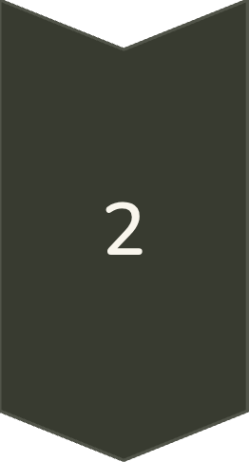
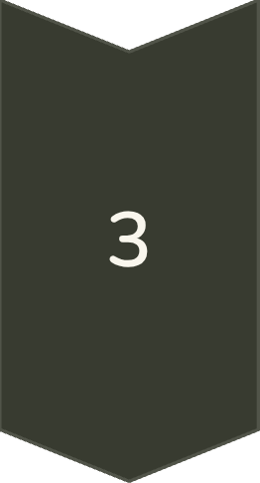
MODULE 2
Narrow AI vs. General AI
Narrow AI (Weak AI)
Designed to perform one specific task extremely well. Examples include facial recognition, spam filters, recommendation algorithms (Netflix, YouTube), and voice assistants like Siri. All AI tools widely used today are Narrow AI — they excel in their domain but cannot transfer skills outside it.
General AI (Strong AI / AGI)
A theoretical form of AI that can understand, learn, and apply intelligence across any task — just like a human. AGI does not yet exist. It remains the long-term goal of AI research, capable of reasoning across domains without retraining.
Key Difference for Trainees
When using AI tools at work or in training, you are always interacting with Narrow AI. Understanding this distinction helps set realistic expectations: today's AI is a powerful specialist, not an all-knowing mind. Always guide it with clear, specific instructions.
Munzurul Islam

Slide 6
☕
⏰ Resume Time
We will reconvene after the lunch break. Please be back on time for the afternoon session.
Lunch Time
💡 Reflection Prompt
Take a Break — Recharge & Reflect
Over lunch, think of one AI tool you have used before. How would you now describe it — Narrow AI or General AI? We will discuss when we return.
You have covered the foundations of AI — its definition, history, milestones, and types. Rest well. We resume shortly with real-world AI applications and hands-on prompt practice.
Munzurul Islam

Slide 7



MODULE 3
AI Understanding & Applications
Healthcare
Education
AI assists in diagnosing diseases, analyzing medical images, predicting patient outcomes, and accelerating drug discovery — saving lives at scale.
Personalized learning platforms, AI tutors, automated grading, and adaptive content delivery improve training outcomes for learners of every level.
Business & Finance
Creative Work
AI powers fraud detection, customer service chatbots, market prediction models, and automated reporting — making organizations faster and smarter.
AI generates text, images, music, and video. Tools like ChatGPT, DALL·E, and Midjourney are reshaping content creation, design, and communication.
Munzurul Islam

Slide 8


MODULE 4
Understanding the Use of Prompts in AI Tools
❌ Weak Prompt
"Tell me about AI."
A prompt is the instruction or question you give to an AI tool. The quality of the AI's output is directly determined by how well you craft your prompt. This skill — called prompt engineering — is one of the most valuable competencies for any AI user today.
✅ Strong Prompt
"Explain the difference between Narrow AI and General AI in simple terms, using two real-world examples. Write it for a beginner audience."
Give Context
Set the Format
🔑 Key Principle
Explain relevant background details.
Specify desired output structure.
The more specific, contextual, and clear your prompt, the more useful and accurate the AI response will be. Think of it as giving directions — vague directions get you lost.
🔄 Iterate Always
Be Clear
Refine & Iterate
State exactly what you need.
Improve prompts based on results.
Good prompting is a conversation. If the first result isn't right, refine your prompt by adding constraints, examples, or a different format request.
Munzurul Islam

Slide 9







WRAP-UP
Introduction to AI: What You've Learned Today
Definition of AI
History & Milestones
AI is the simulation of human intelligence — learning, reasoning, and adapting — performed by machines and software systems.
From Turing in 1950 to ChatGPT in 2022, AI has evolved through decades of breakthroughs, setbacks, and transformative leaps.
Narrow AI vs. General AI
AI Applications
Today's tools are all Narrow AI — powerful specialists. General AI remains a future goal. Knowing the difference shapes how we use and trust AI.
AI is already transforming healthcare, education, business, and creative industries — and its role continues to grow every year.
Prompting AI Tools
Clear, specific, and context-rich prompts unlock the best results. Prompt engineering is a skill every trainee can start practicing today.
"AI is not magic — it is a tool. The better you understand it, the more powerfully you can use it."
— Munuzurul Islam
Munzurul Islam

